Slide 1
Wearable 기기를 통한 AF screening
원주세브란스기독병원 심장내과
박영준

Slide 2
The prevalence of AF
AF prevalence progressively increased > x2 for the last 10 years
AF prevalence in Korea is expected to be 5.8% in 2060
Mainly among those > 70years
American Heart Journal 202 (2018) 20-26

Slide 3
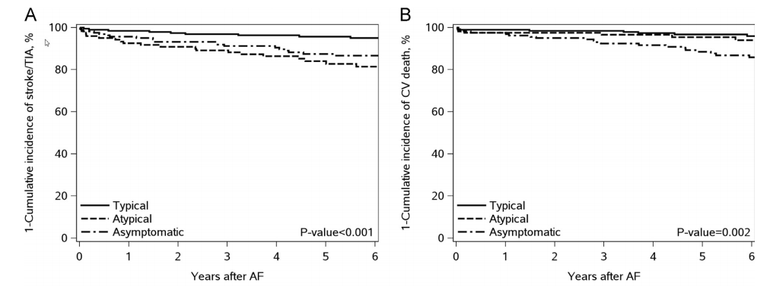
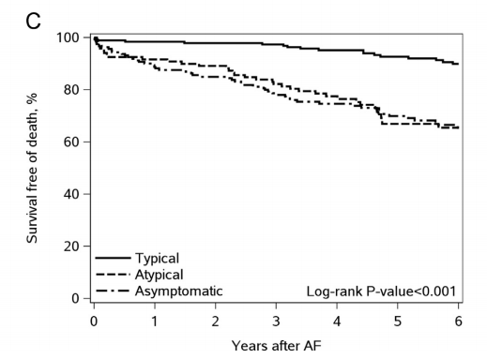
Asymptomatic AF
1/3 of patients with AF are asymptomatic
1/3 of patients with AF-related stroke were not aware of having AF before stroke.
Stroke/TIA
CV Death
All cause death
Heart Rhythm 2016;0.:1418-24 J Neurol Neurosurg Psychiatry 2017; 88:744-748

Slide 4
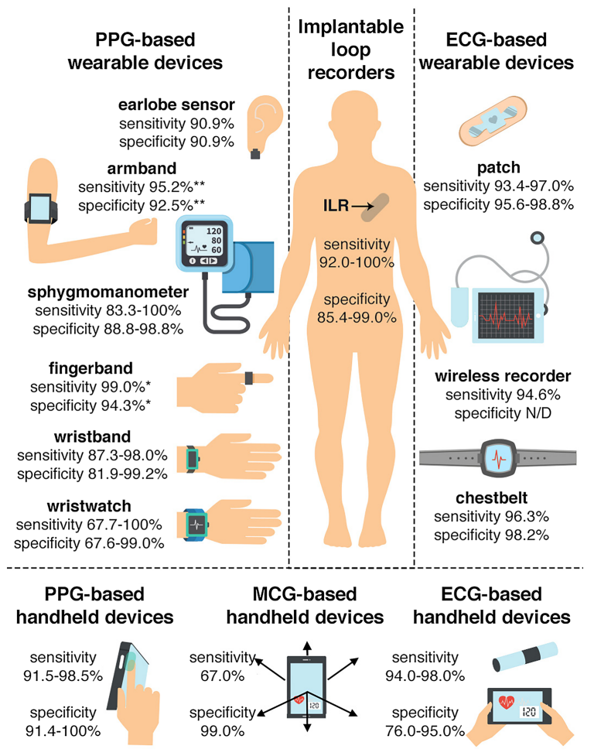
Screening Tools
Circulation. 2021;143:372-388
Circulation. 2021;143:372-388

Slide 5
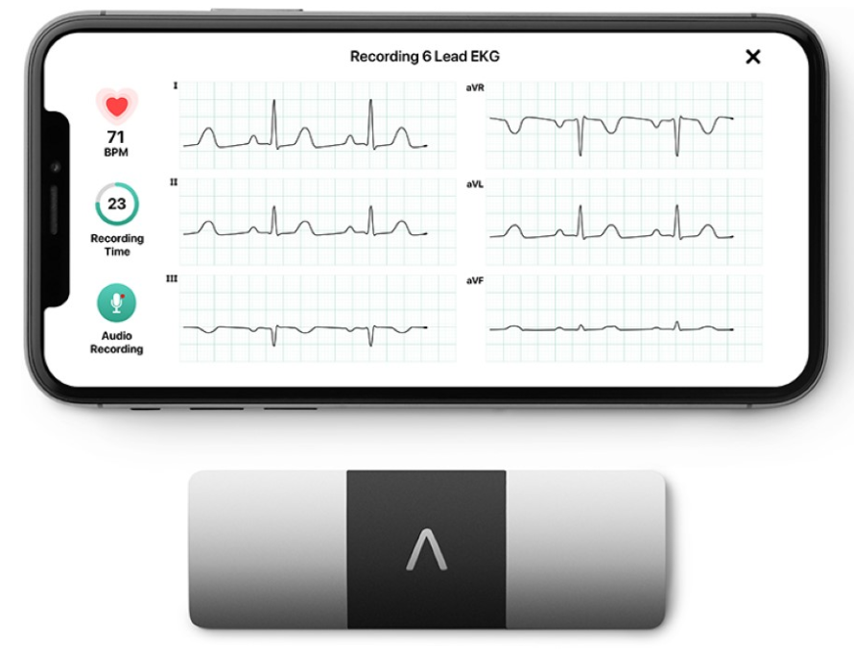
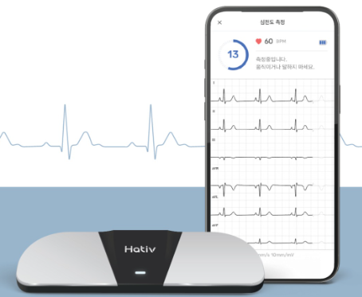
Handheld ECG
Single lead, 6 lead ECG(limb lead)
ECG base
10~30sec
Intermittent, Repetitive
Consumer based
Cost effective

Slide 6
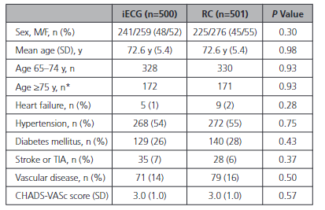
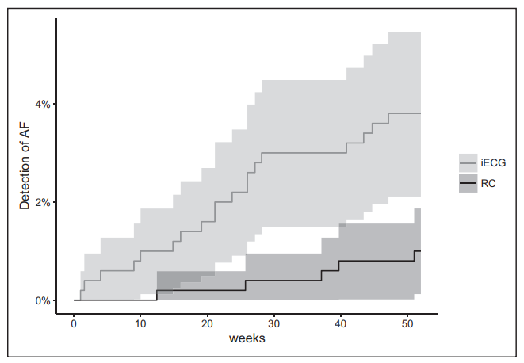
REHEARSE-AF (Handheld ECG)
RCT, 1,001 patients, screen vs. control
age >65, C-V score ≥2
Twice weekly, 30sec, 12months (Alivecor)
primary outcome : AF detection
3.8% vs 1.0%
Circulation. 2017 Nov 7;136(19):1784-1794

Slide 7
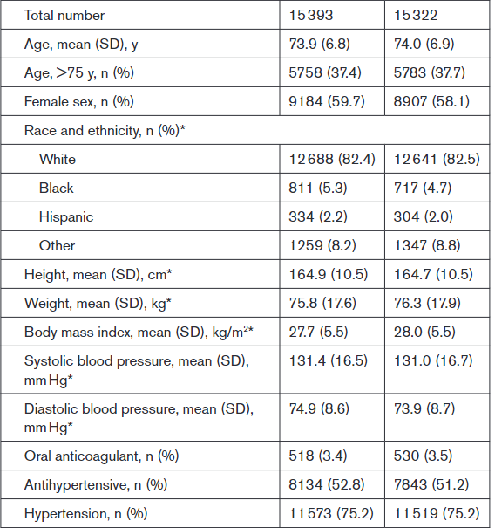
Screening for AF in Older adults at Primary Care Visits : VITAL-AF study
RCT, point-of-care screening for AF at primary care visits
3,0715 patients: ≥65yrs without AF
screening vs. usual care 1:1, handheld single-lead ECG (AliveCor) → AF diagnosis within 12months
Screening Control
Median visit per person 2
CHA2DS2VASc score : 3.4
Outcome:
264/15383(1.72%) vs 243/15322(1.59%)
Screening for AF using handheld ECG at primary care visits did not affect new AF diagnosis older than 65 years
Circulation. 2022;145:946-954
Notes:
The proportion of individuals with newly diagnosed AF who were initiated on oral anticoagulants was not different in the screening (n=194, 73.5%) and control (n=172, 70.8%) arms (risk difference, 2.7% [95% CI, –5.5 to 10.4]).

Slide 8
Screening for AF in Older adults at Primary Care Visits : VITAL-AF study
Subgroup analysis stratified by age
Overall
5.56 vs 3.76%
1.72 vs 1.59% (p=0.38)
Circulation. 2022;145:946-954
Notes:
The proportion of individuals with newly diagnosed AF who were initiated on oral anticoagulants was not different in the screening (n=194, 73.5%) and control (n=172, 70.8%) arms (risk difference, 2.7% [95% CI, –5.5 to 10.4]).

Slide 9
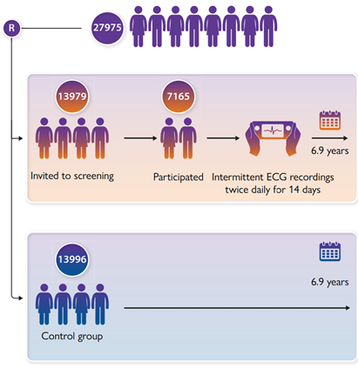
Clinical Outcomes with Systematic Screening for AF (STROKESTOP study)
RCT, n=27,958, 75-76yr
Screening (participant, non-participant) vs. control (1:1)
Twice daily, two weeks (hand-held ECG, Zenicor)
Outcome: ischemic or hemorrhagic stroke, systemic embolism,
bleeding, and all-cause mortality
CHA2DS2VASc score : 3.5
Lancet 2021; 398: 1498-1506
Notes:
ur findings suggest that screening for atrial fibrillation in an older population has a net beneficial effect and should be considered as part of health-care policy.

Slide 10
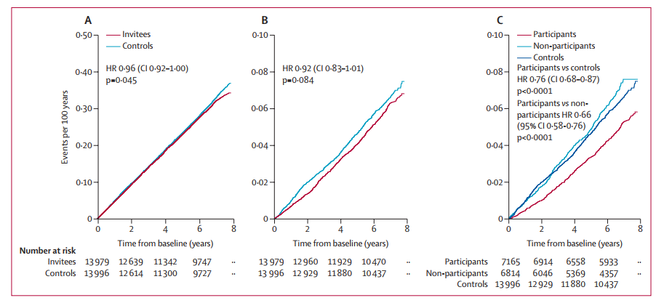
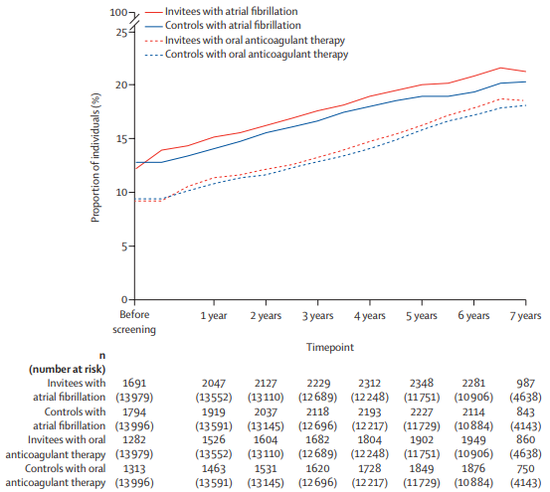
Clinical Outcomes with Systematic Screening for AF (STROKESTOP study)
Composite Outcome
Ischemic stroke/SE
Ischemic stroke/SE
Screening for atrial fibrillation in an older population showed net clinical benefit by reducing embolic evnets
Lancet 2021; 398: 1498-1506

Slide 11
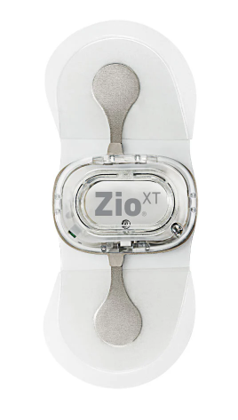
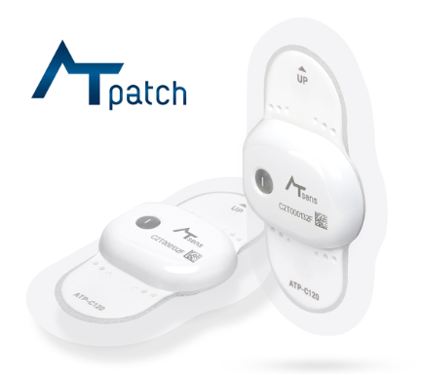
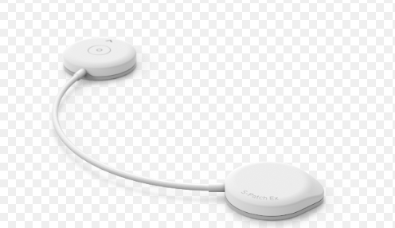
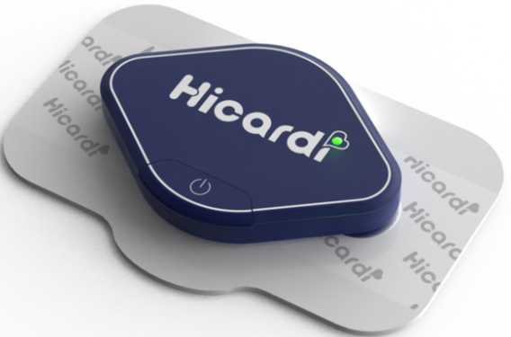
Single lead ECG
Single lead
ECG base
Within15 days
Continuous
Hospital based
Reuseable or single use

Slide 12
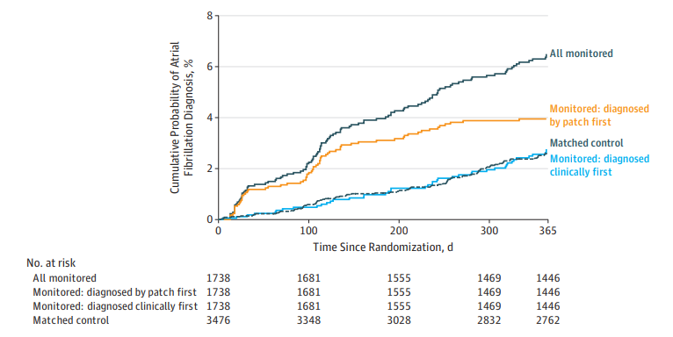
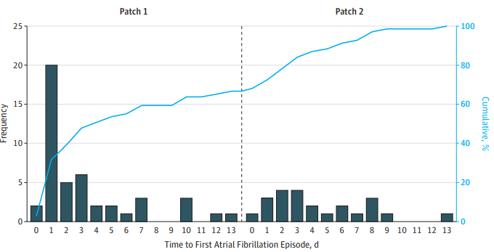
mSToPS Study (Patch)
RCT, 2659 patients, Monitoring group(immediate, delayed) vs matching group(n=3476)
Two weeks continuous ECG (patch) twice
age ≥ 75 yrs or male > 55 year/ female > 65 with one comorbidities
CHA2DS2-VASc score 3.0
AF detection : 53/1366 (3.9%) vs. 12/1293 (0.9%) at 4 months
109/1738(6.7 per 100 PYS) vs 81/3476(2.6 per 100 PYS) at 1 years
Anticoagulation: 5.7 vs 3.7 per 100 PYS
JAMA. 2018 Jul 10;320(2):146-155

Slide 13
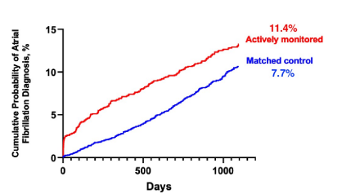
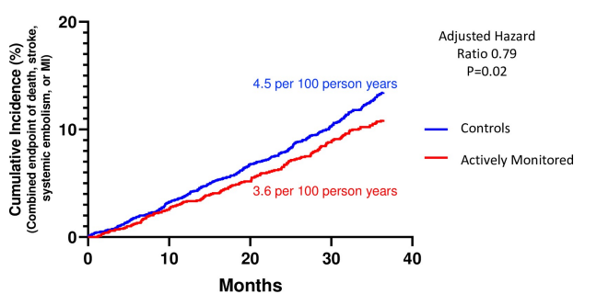
mSToPS Study 3 years f/u (Patch)
1718 active monitor vs 3371 observational control. 29 months
New AF diagnosis 3.2 per 100 PYS vs 3.4 per 100PYS
Stroke 1.7 vs 2.2(HR 0.75, p 0.04)
Individuals undergoing active screening for AF experienced a lower rate of clinical events at 3 year .
PLoS One. 2021 Oct 5;16(10):e0258276

Slide 14
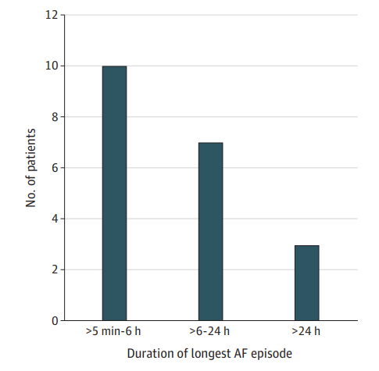
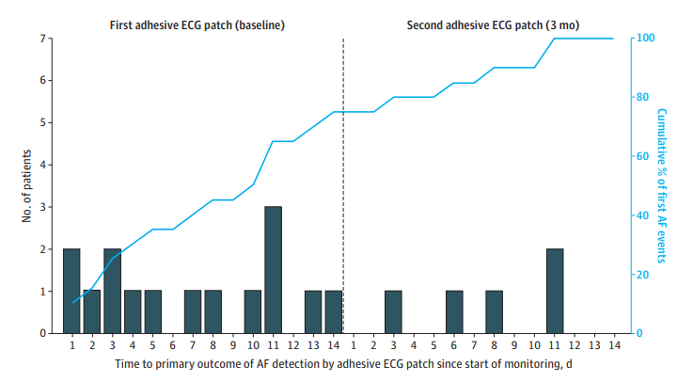
SCREEN-AF Study (Patch)
RCT, 856 patients, screen vs. control (pulse auscultation, heart auscultation)
Two weeks continuous ECG (patch) twice(baseline, after 3 months) 6months f/u
age ≥ 75 yrs with HT
More AF detection : 23/434 (5.3%) vs. 2/422 (0.5%) (Relative risk 11.2, 95% CI 2.7-47.1, p=0.001)
Oral anticoagulation: 18/434 (4.1%) vs. 4/422 (0.9%) (Relative risk 4.4, 95% CI 1.5-12.8, p=0.007)
JAMA Cardiol. 2021 May 1;6(5):558-567.

Slide 15
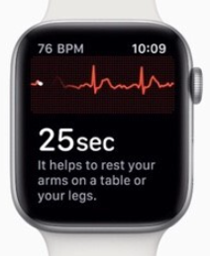
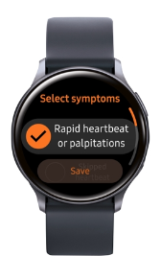
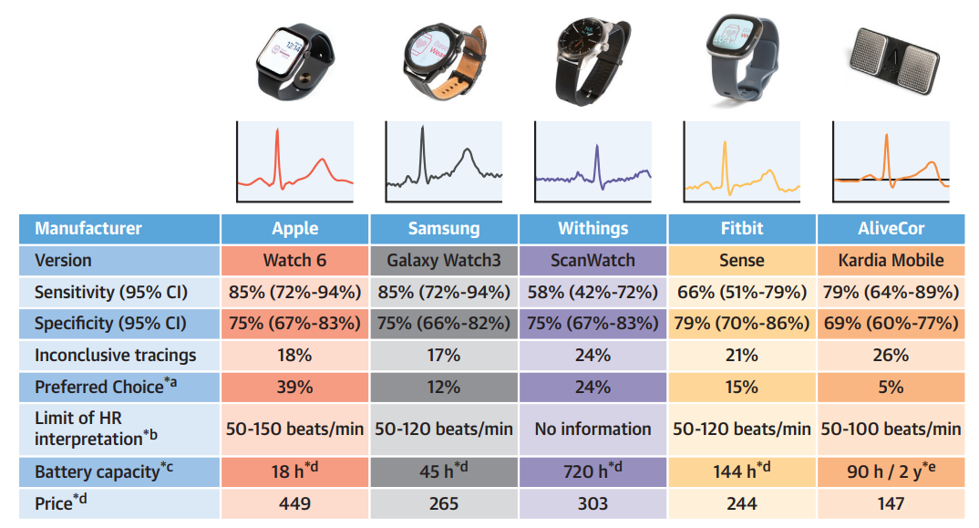
Smartphone and smart watch
PPG & ECG base(Single lead)
30sec
Intermittent
Consumer based
JACC Clin Electrophysiol. 2023 Feb;9(2):232-242

Slide 16
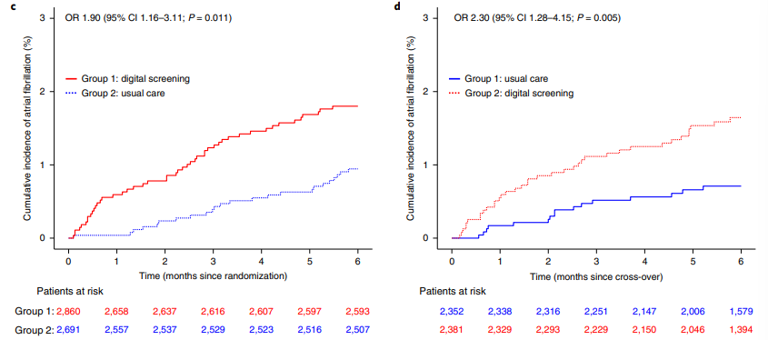
eBRAVE-AF(smartphone)
RCT cross over, 5551 patients, Digital screening vs usual care, each phase 6 months
1-minute PPG pulse wave using smartphone app(Preventicus)
Confirm by external ECG loop recorder(CadioMem CM 100XT)
50–90 years with a CHA2DS2-VASc score of ≥1 (men) or ≥2(women)
CHA2DS2-VASc score 3.0 Phase 1 Phase 2
Group1 Group2
Phase 1 1.33% vs 0.63% (OR 2.1)
Phase 2 0.51% vs 1.38% (OR 2.7)
Increased prescribed OAC(OR 2.00), but no difference in stroke, embolic event, MACCE, death
Nat Med. 2022 Sep;28(9):1823-1830.

Slide 17
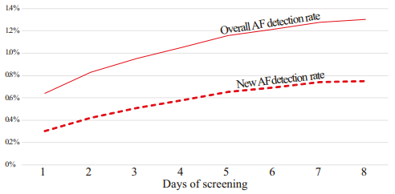
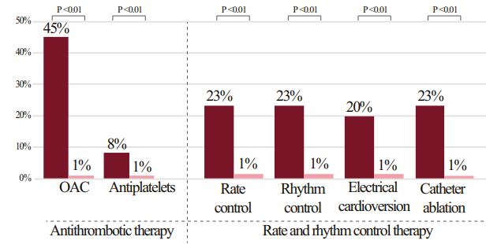
Smart phone based AF screening
62,807 subjects download screening application(FibriCheck©)
60,629(97%) preformed at least one PPG measurement.
Mean age 59, men 57%
AF detected 791(1.3%), Clinical AF(n=395), Subclinical AF(n=396)
Eur Heart J Digit Health. 2023 Sep 30;4(6):464-472.

Slide 18
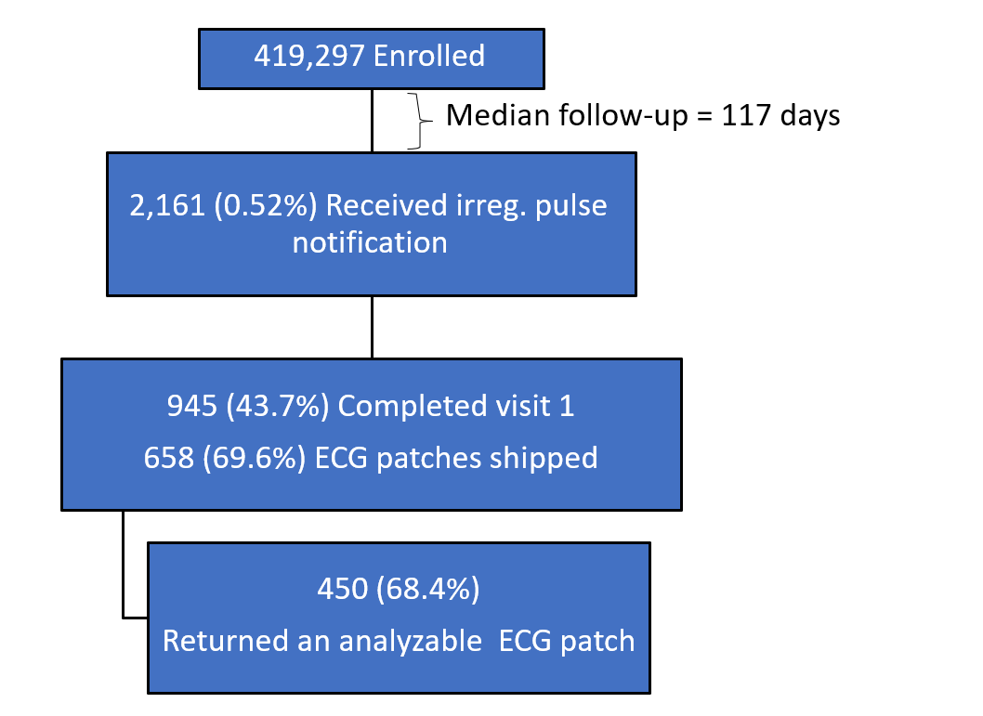
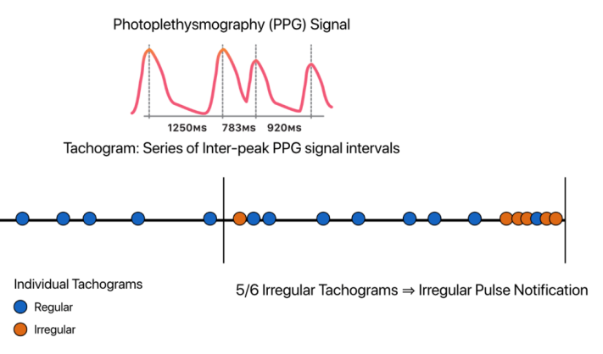
Apple Heart Study
Remote 1-arm trial based on Apple Watch linked to the trial iPhone app, 2017-2018, in U.S.:
- Eligibility: Age 22+, no prior hx AF, no OAC , own Apple Watch and iPhon
- Algorithm detects irregular pulse (PPG) → notification
- Remote physician visit confirms eligibility and ships 7-day 1-lead ECG patch
Median age 41, 42% female, CHA2DS2VASc score≥2 13%
N Engl J Med 2019;381:1909-17.

Slide 19
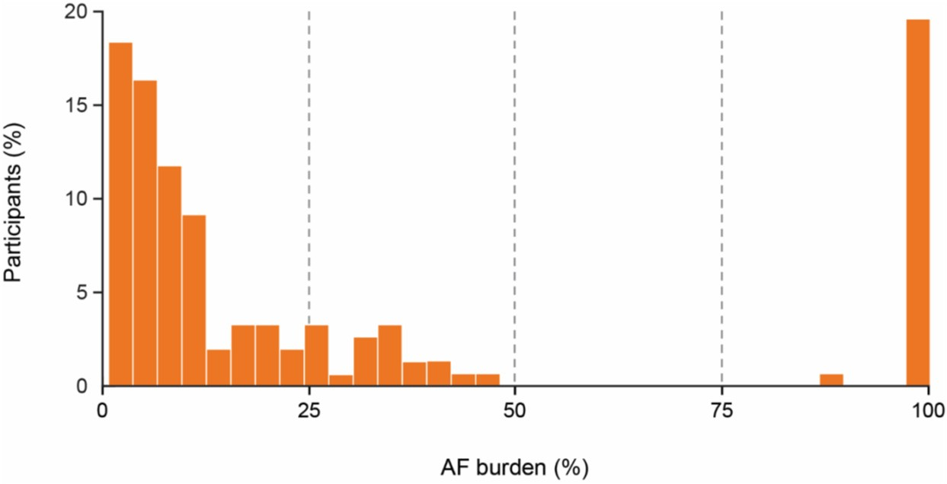
Apple Heart Study
ECG patch results (~13 days after irreg pulse notification):
Aim 1a: 34% (153/450) had ECG confirmed AF
Aim 1b: Positive predictive value (PPV) wearing patch
For any individual, PPV = 0.84
PPV worse for older individuals due to APCs
Median AF burden ~~13% on ECG patch:
N Engl J Med 2019;381:1909-17.

Slide 20
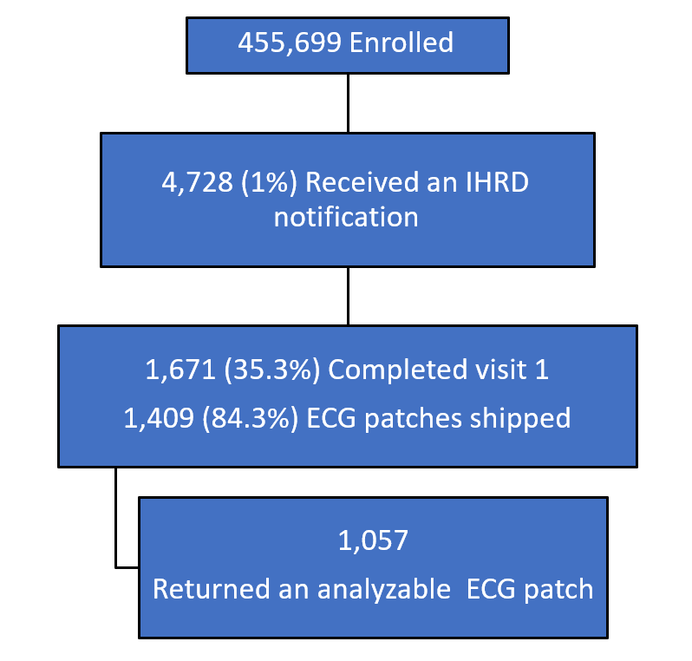
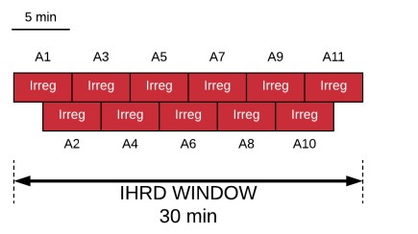
Fitbit Heart Study
Remote 1-arm trial based on Fitbit device with android or apple iOS smartphone, 2020 in U.S.:
- Eligibility: Age 22+, no prior hx AF, no OAC
- Algorithm detects irregular pulse (PPG) → notification
- Remote physician visit confirms eligibility and ships 7-day 1-lead ECG patch
Median age 47, 71% female, CHA2DS2VASc score 1.2, CHA2DS2VASc score≥2 35%
Circulation. 2022 Nov 8;146(19):1415-1424

Slide 21
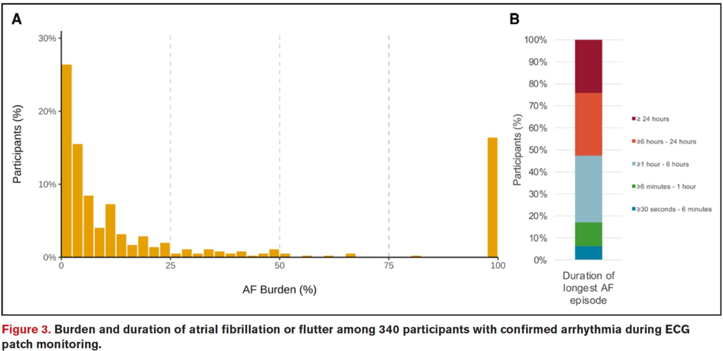
Fitbit Heart Study
ECG patch results:
22% (241/1057) had ECG confirmed AF
Median AF burden 7% on ECG patch
Median longest episode: 7 hours (2-22 hours)
Circulation. 2022 Nov 8;146(19):1415-1424

Slide 22
Cost-effectiveness of AF screening
- More cost-effective than routine practice
- Patients ≥ 65 yrs
- Both systematic and opportunistic
2017 EHRA consensus, Europace (2017) 19;1589-1623
Notes:
Cost-effectiveness of screening for atrial fibrillation in primary care with a handheld,
single-lead electrocardiogram device in the Netherlands. Europace
2018;20:1218.
Feasibility and cost-effectiveness of stroke prevention through
community screening for atrial fibrillation using iPhone ECG in pharmacies. The
SEARCH-AF study. Thromb Haemost 2014;111:11671176.
Cost-effectiveness of mass screening for untreated atrial fibrillation
using intermittent ECG recording. Europace 2015;17:10231029.
Screening to identify unknown atrial fibrillation. A systematic review. Thromb Haemost 2013;110:213222.

Slide 23
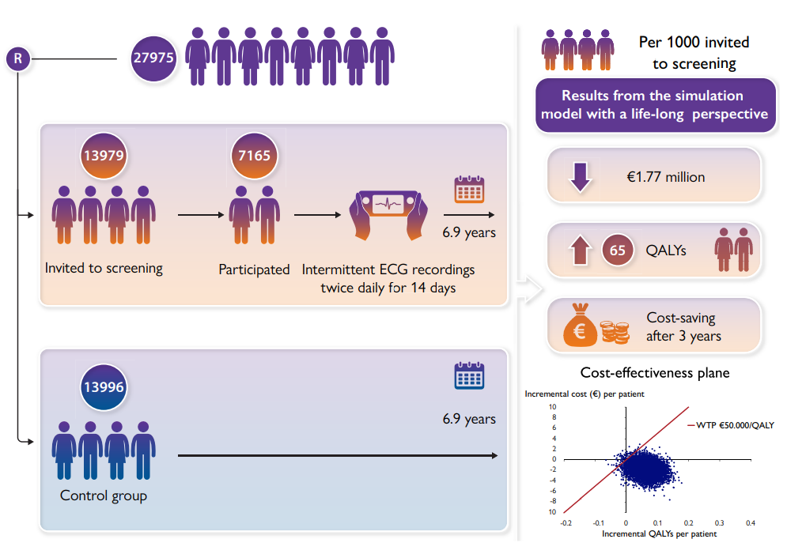
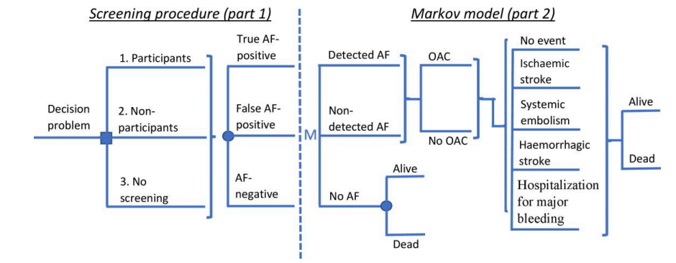
Cost-effectiveness of AF screening(STROKESTOP study)
European Heart Journal (2023) 44, 196–204
Notes:
Cost-effectiveness of screening for atrial fibrillation in primary care with a handheld,
single-lead electrocardiogram device in the Netherlands. Europace
2018;20:1218.
Feasibility and cost-effectiveness of stroke prevention through
community screening for atrial fibrillation using iPhone ECG in pharmacies. The
SEARCH-AF study. Thromb Haemost 2014;111:11671176.
Cost-effectiveness of mass screening for untreated atrial fibrillation
using intermittent ECG recording. Europace 2015;17:10231029.
Screening to identify unknown atrial fibrillation. A systematic review. Thromb Haemost 2013;110:213222.

Slide 24
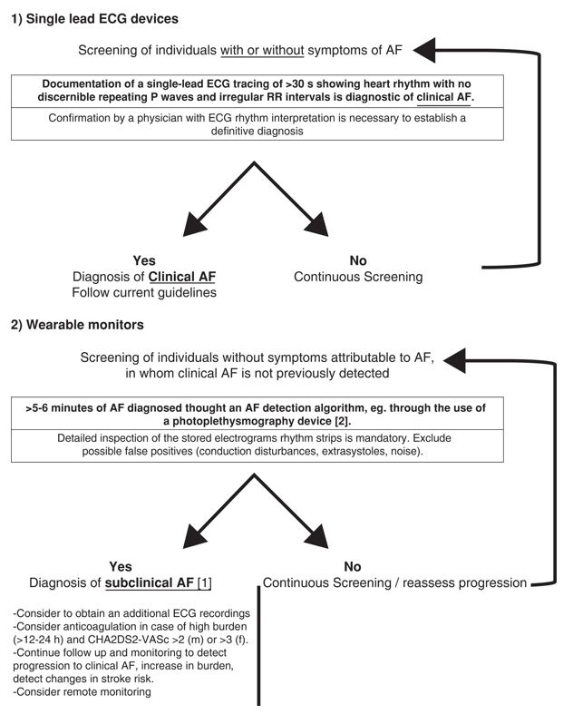
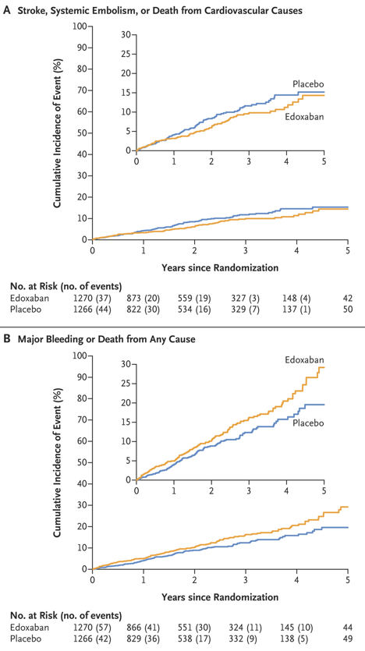
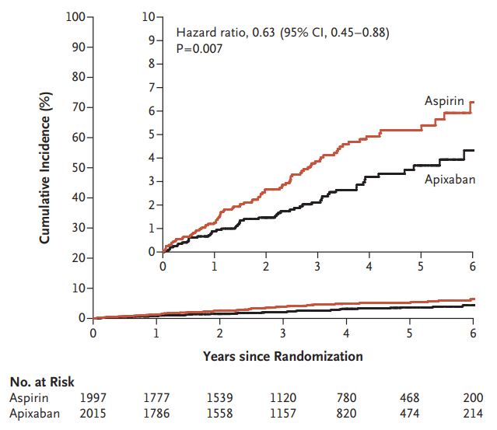
Clinical AF vs subclinical AF
NOAH-AFNET 6 trial
Atresia trial
Europace. 2023 Feb 8;25(1):185-198
N Engl J Med. 2023 Sep 28;389(13):1167-1179
N Engl J Med. 2023 Nov 12. do
Notes:
Cost-effectiveness of screening for atrial fibrillation in primary care with a handheld,
single-lead electrocardiogram device in the Netherlands. Europace
2018;20:1218.
Feasibility and cost-effectiveness of stroke prevention through
community screening for atrial fibrillation using iPhone ECG in pharmacies. The
SEARCH-AF study. Thromb Haemost 2014;111:11671176.
Cost-effectiveness of mass screening for untreated atrial fibrillation
using intermittent ECG recording. Europace 2015;17:10231029.
Screening to identify unknown atrial fibrillation. A systematic review. Thromb Haemost 2013;110:213222.

Slide 25
Current Recommendations
AF screening is recommended by a number of guidelines, but not all.
→ controversy exists as to the optimal approach
→ target population, screening tools, impact on outcome
Guideline
ESC(2020) APHRS CCS | Opportunistic AF screening by pulse taking or ECG rhythm strip in ≥ 65yrs (Class I, B) Systematic AF screening in individuals aged ≥ 75yrs (Class IIa, B)
ACC(2023) | No recommendation
USPSTF(2022) | Inadequate evidence to assess whether AF screening with ECG, Asymptomatic adults 50 years or older

Slide 26
Ongoing trial
European Heart Journal Open (2023) 3, 1–13

Slide 27
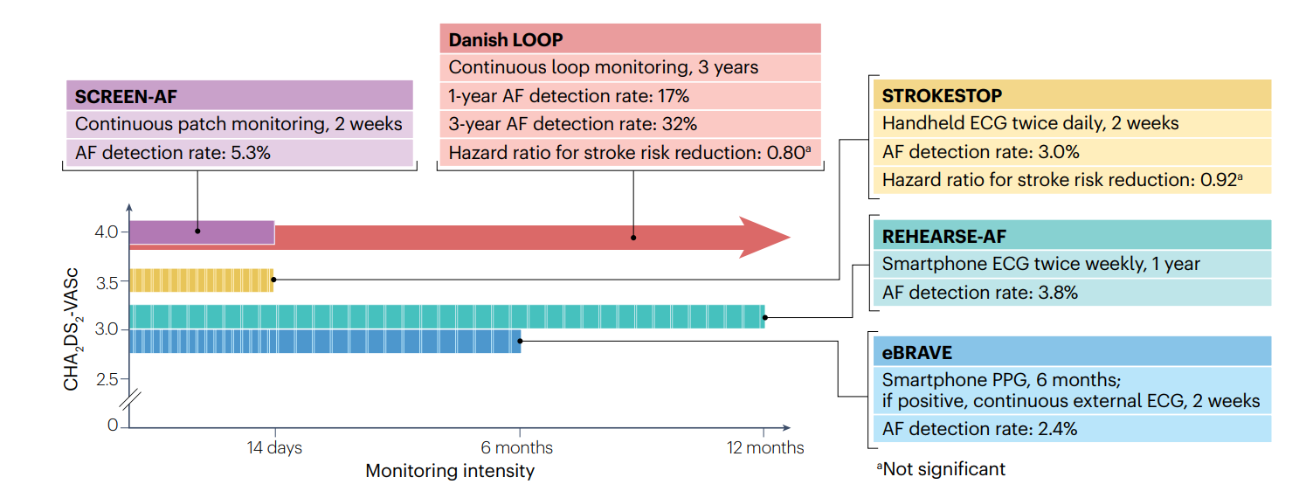
RCT on atrial fibrillation screening
Nat Rev Cardiol. 2023 Jan;20(1):1-2

Slide 28
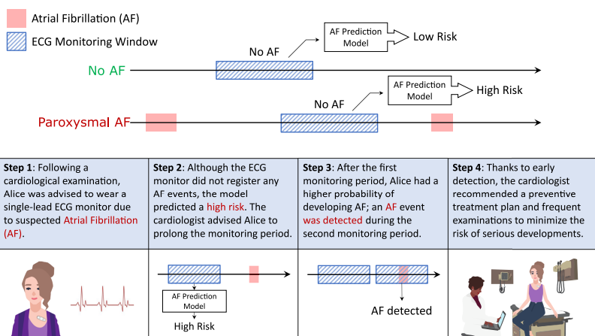
Application of the AF prediction AI model
NPJ Digit Med. 2023 Dec 12;6(1):229.

Slide 29
Conclusions
AF is most common arrhythmia. It is major risk factor of stroke and often goes undetected.
Variable screening tools are ready.
More frequent or longer ECG monitoring results in increased AF diagnosis.
But, Improved AF diagnosis ≠ improved clinical outcomes
Careful selection of the target population & appropriate screening tools, demonstrating impact on outcome

Slide 30
Thank you for your attention

